Slide 1
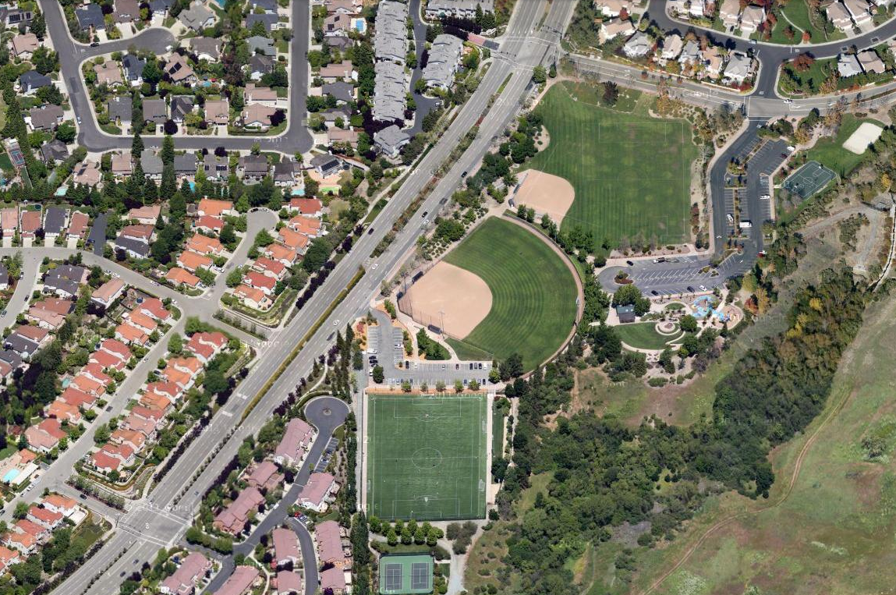
Diablo Vista Park
1000 Tassajara Ranch Road, Danville, CA
Tassajara Ranch Road
Soccer East
Crow Canyon Road
60’ East Ball Field
80’ Lighted Ball Field
P
P
Crow Canyon Road
Artificial Turf Field
Indian Rice Road
Tennis Courts

